Slide 1

Interfaces In Java Discussion & Lecture Eric Pogue
Agenda for Wednesday, February 26th at 11am CT:
Introductions
Interfaces In Java Preview
Object-Oriented Programming
Interfaces in Java
Interfaces in Other Languages
Questions & Answers
Discussion & Questions welcome at any time… please be present with no phones or email during our time together
Notes:
Thank you to Dr. Perry (Jason)
Just to clarify, this is not a lecture on User Interfaces in Java.

Slide 2
Introductions

Slide 3
Introductions
Name:
Eric Pogue
Background:
Married with five children, relocated from Davenport, IA to Chicago area a few years back
Professional Experience:
Decades in the industry as a developer, architect, project manager, division manager, and vice president of various software development organizations.
Part of many teams that have delivered products to tens of millions of customers globally for
Parsons Technology, Intuit, The Learning Company, Jasc Software, and John Deere
… and most recently working on a startup product “Stadia” with my oldest son
Fun Fact:
At one point I had the very dubious “honor” or being the most traveled John Deere employee to India with 40+ trips over a 5-year+ period while setting up the 400+ person John Deere Technology Center – India application development organization.

Slide 4
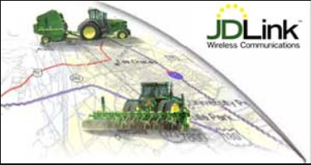







Slide 5
Cyber Security and Programming?
Notes:
Zach, George, and David
Programming Background
Java
Object-Oriented Programming
Encapsulation
Inheritance
Polymorphism

Slide 6
Interfaces In Java

Slide 7
Interfaces In Java
Within Java an Interface is an abstract type that is used to specify a set of methods that a class must implement. Interfaces are declared utilizing the “interface” keyword and contain only the method signatures comparable to declaring an abstract method within a class.
Interfaces were introduced as an alternative to multiple inheritance.
Notes:
Interfaces can also contain contain variables and inherit from one or more other interfaces.

Slide 8
Interfaces In Java
Within Java an Interface is an abstract type that is used to specify a set of methods that a class must implement. Interfaces are declared utilizing the “interface” keyword and contain only the method signatures comparable to declaring an abstract method within a class.
Interfaces were introduced as an alternative to multiple inheritance.
Notes:
Interfaces can also contain contain variables and inherit from one or more other interfaces.

Slide 9
Interfaces In Java
Within Java an Interface is an abstract type that is used to specify a set of methods that a class must implement. Interfaces are declared utilizing the “interface” keyword and contain only the method signatures comparable to declaring an abstract method within a class.
Interfaces were introduced as an alternative to multiple inheritance.
Notes:
Interfaces can also contain contain variables and inherit from one or more other interfaces.

Slide 10
Object-Oriented Programming
Classes & Objects
Encapsulation, Inheritance, Polymorphism
… and Abstraction
Interfaces
Notes:
Helpful Interview Hint: Whenever you are asked a conceptual question about object-programming in a software development interview (and you will be), answer confidently “Encapsulation”, “Inheritance”, and “Polymorphism”.
When asked what is Encapsulation (or how would you implement it), say, “I would limit or minimize variable scope and keep data attributes private as often as possible.”
Now as we are going through our object-oriented examples, be thinking about how you would answer the “What is Inheritance?” and “What is Polymorphism?” interview questions. Note that answering them both with very brief examples can be very effective… and it is always best to use animals in you OOP interview examples.
Now we just need to make sure that we are able to effectively utilize these concepts after we get the job. Let’s start by walking through an example.

Slide 11
Object-Oriented Programming

Slide 12
Classes
Object-oriented programming is a programming model based on Classes which contain both Properties (member variables) and Methods (member functions) that operate on that those Properties.
Shape
Circle
Rectangle
Square
Notes:
I will often start with definitions from Wikipedia and other sources. If you are struggling with a topic and/or would like more information, it can often be valuable to review the references. You should be able to click on the [link] tag (possibly while holding the shift key down) in order open the reference in a browser.
Properties are the same as Attributes or member variables
Methods are the same a member functions

Slide 13
Classes & Objects
Most popular OOP languages are class-based, meaning that Objects are instances of Classes.
Notes:
I will often start with definitions from Wikipedia and other sources. If you are struggling with a topic and/or would like more information, it can often be valuable to review the references. You should be able to click on the [link] tag (possibly while holding the shift key down) in order open the reference in a browser.
Properties are the same as Attributes or member variables
Methods are the same a member functions

Slide 14
The “Big Three” Object-Oriented Concepts
Encapsulation
Inheritance
Polymorphism
Notes:
Helpful Interview Hint: Whenever you are asked a conceptual question about object-programming in a software development interview (and you will be), answer confidently “Encapsulation”, “Inheritance”, and “Polymorphism”.
When asked what is Encapsulation (or how would you implement it), say, “I would limit or minimize variable scope and keep data attributes private as often as possible.”
Now as we are going through our object-oriented examples, be thinking about how you would answer the “What is Inheritance?” and “What is Polymorphism?” interview questions. Note that answering them both with very brief examples can be very effective… and it is always best to use animals in you OOP interview examples.
Now we just need to make sure that we are able to effectively utilize these concepts after we get the job. Let’s start by walking through an example.

Slide 15

More Object-Oriented Programming Concepts
The “Big Three” Concepts:
Encapsulation... and Information Hiding
Inheritance
Polymorphism
Additional Important Object-Oriented Terms:
Abstraction utilizing Abstract Classes or Interfaces
Ownership through Composition & Aggregation

Slide 16
Encapsulation… and Information Hiding
Encapsulation: Restricting access and visibility of Properties and Methods of a Class in order to make the Class easier to utilize, extend, and maintain. [link]
Information Hiding: The Information Hiding term is often used interchangeably with Encapsulation. Information Hiding does not connection with Object-Oriented Programming and can be used to describe practices utilized in non-OOP languages as well. [link]

Slide 17
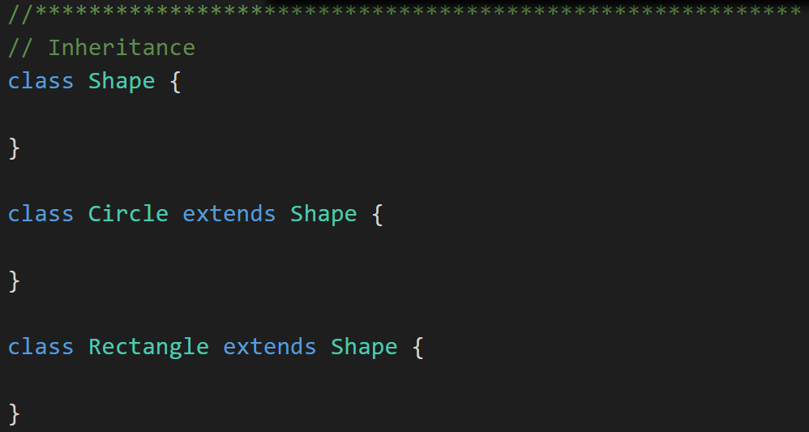
Inheritance
Inheritance: When one Class acquires the Properties and Methods of another Class it is called Inheritance. [link]
Shape
Circle
Rectangle
Square
Notes:
The first of many “Shape” examples. We will get to a Abstraction example in a few minutes.

Slide 18
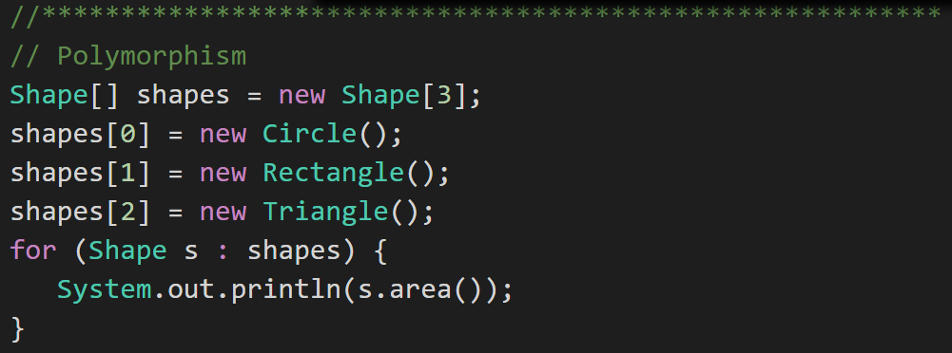
Polymorphism
Polymorphism: Polymorphism enables you to process collections of related things generically. This is particularly useful when you want to use a loop to march through a collection of items. [link]
Notes:
Example of polymorphism: a for loop that moves through the entries of a list. The list might be of a collection of related kinds of object. We can refer to each of the objects in the list through a generic variable (whose data type matches the one that all are ultimately related to). But, when we invoke a particular function that all members of the family share, each will respond by performing that function in their own specific way. For example, we could have a collection of Shape objects. We could refer to each entry in the Shape list through a generic Shape variable, even though the actual entries in the list are specific kinds of shapes – Circle, Rectangle, etc. All Shape objects might have the ability to calculate their own area. When we refer to an object in the list through a generic Shape variable and tell it to calculate its area, thanks to polymorphism, the circle version of the area() function will be called when we’re dealing with a circle, and the Rectangle version of area() will be called when we’re dealing with a rectangle, etc.
The first time through the for loop, we’ll call the Circle.area() function – actually, we won’t; it will happen automatically. The next time through, we’ll call the Rectangle version, and then we’ll call the Triangle version.
Polymorphism is implemented behind the scenes using a Virtual Method Table (VMT). The VMT keeps track of where various related classes’ same-named functions are located in memory. Using the VMT, the operating system is able to figure out which code to implement when we tell each shape to fire its area() function.

Slide 19
More Object-Oriented Programming Concepts
The “Big Three” Concepts:
Encapsulation... and Information Hiding
Inheritance
Polymorphism
Additional Important Object-Oriented Terms:
Abstraction utilizing Abstract Classes or Interfaces
Ownership through Composition & Aggregation

Slide 20
Abstraction
Abstraction: Something is abstract when it is a concept but is not concrete or defined enough to be built. Generally, in OO design, we start with abstract things, and then we build on them through Inheritance. [link]
Abstraction can be implemented through Abstract Classes or by utilizing Interfaces.
Notes:
The first of many “Shape” examples. We will get to a Abstraction example in a few minutes.

Slide 21
Object-Oriented Programming
Within Java an Interface is an abstract type that is used to specify a set of methods that a class must implement. Interfaces are declared utilizing the “interface” keyword and contain only the method signatures comparable to declaring an abstract method within a class.
Interfaces were introduced as an alternative to multiple inheritance.
Notes:
Interfaces can also contain contain variables and inherit from one or more other interfaces.

Slide 22
Interfaces In Java
Within Java an Interface is an abstract type that is used to specify a set of methods that a class must implement. Interfaces are declared utilizing the “interface” keyword and contain only the method signatures comparable to declaring an abstract method within a class.
Interfaces were introduced as an alternative to multiple inheritance.
Notes:
Interfaces can also contain contain variables and inherit from one or more other interfaces.

Slide 23
Coding Practice: “Shapes With Interfaces”
Notes:
Now that we have looked at the theory and some code segments, let’s take a look at an application that demonstrates Interfaces in Java.

Slide 24
Interfaces Across Languages
C++
No formal concept of of Interfaces but support multiple inheritance
Java
Supports single inheritance and utilizes interfaces as a substitute for multiple inheritance
Go
Does not support inheritance but utilized interfaces as a substitute

Slide 25
Inheritance vs Interfaces
Why do languages seem to be embracing Interfaces at the expense of Inheritance?
Interfaces eliminate some o the challenges when developing multi-threaded applications relative to Inheritance
Interfaces are easier to implement across languages
Interfaces are easier to implement across the network

Slide 26
Summary

Slide 27
Questions & Answers

Slide 28
End of Session

Slide 29
Friendly Conversation Topic “Most developers know JavaScript — and want to know Go”
Notes:
https://www.infoworld.com/article/3519613/most-developers-know-javascript-and-want-to-know-go.html

Slide 30
Go
Go is the programming language developers most wanted to learn, for the third year running.
Notes:
HackerRank

Slide 31
Interested in Learning More?
Notes:
HackerRank

Slide 32

Interested in Learning More?
Notes:
HackerRank

Slide 33
Safari Books Online & Lewis University
Notes:
HackerRank

Slide 34
Object-Oriented Programming Language History
Simula late 1960s
Smalltalk early 1970s
Object Lisp late 1970s
Object Pascal mid 1980s
C++ and Eiffel late 1980s
Java and Python 1990s
C# 2000s
Go, Dart, TypeScript, Swift 2010s

Slide 35
Language Popularity

Slide 36
And we have and example of Abstraction.
Abstraction
Abstraction is another key concept. Something is abstract when it is a concept but is not concrete or defined enough to actually be built. Generally, in OO design, we start with abstract things, and then we build on them through inheritance.
An abstract class is one that has one or more abstract methods.
An abstract method is a method / function that has no body – just a name, return type, and parameters.
An interface is the strictest interpretation of an abstract class – it is a data structure that consists entirely of abstract methods. In other words, none of its methods/functions have a body.
Abstraction is related to inheritance. Often, when we construct families of related objects, we start the family with an abstract class that represents the least common denominator for everyone in that family. In other words, what do all classes that are part of that family have in common? We often (not always, but often) put that in an abstract class.

